Slide 1
Vocational and Professional Education and Training in Switzerland

Slide 2
Switzerland at a glance
Population > 8’000’000
Politics:
  1 Confederation - 26 Cantons – 2396 communes
Economics:
  Primary Sector 1.2%, Secondary Sector 26.8%, Tertiary Sector 72% (GDP)
Linguistics and Culture:
  4 National languages (German: 63%, French: 21%, Italian: 7%, Romansh: 1%, Other: 8%)

Slide 3
VPET: 1 mission – 3 partners
Cantons
Implementation and Supervision
Confederation
Strategic management and development
Private sector
Training content and apprenticeship positions

Slide 4
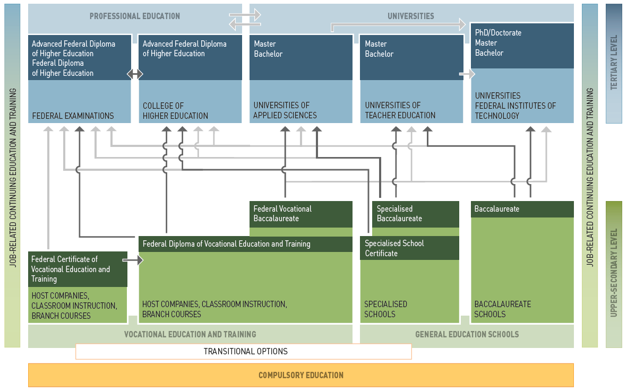
Swiss education system

Slide 5
Swiss education system
Professional education
(PE)
Universities
(academic & applied sciences)
Vocational education and training
(VET)
General education

Slide 6
Permeability
Internship
Aptitude test

Slide 7
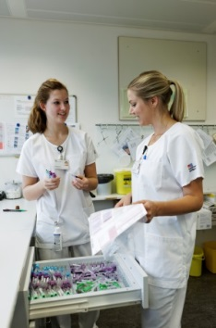
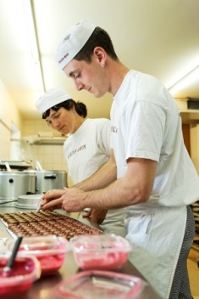
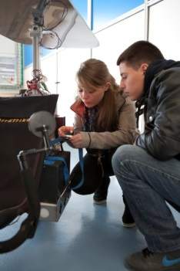

Dual-Track approach to vocational education and training
2-year Federal VET Certificate
3-year or 4-year Federal VET Diploma
Federal Vocational Baccalaureate (FVB)
Practice
Theory
In-company
training
(3-4 days per week)
Classroom instructions at VET-School
(1-2 days per week)

Slide 8
Apprenticeship market
Companies
Supply
Youth
Demand
Apprentice-ship market
Demand for qualified workers
Future-oriented investment / social responsibility
Favourable for the Image
Financial advantages
Work experience
Nationally recognised degree
Very good job prospects
Opportunities for a professional career
State
Economic competitiveness
Labour market adequacy of VPET
Low youth unemployment

Slide 9
Labour market oriented VPET →
High employability
Source: Swiss Federal Statistical Office (FSO) / Swiss Labour Force Survey (SLFS);
Estimates by Federal Department of Economic Affairs, Education and Research (EAER)

Slide 10
Funding of VPET system

Slide 11
Cost/benefit ratio for Swiss companies offering apprenticeships

Slide 12
Strengths of Swiss VPET system
Public-private partnership
Permeability
Labour market orientation
Cost efficiency

Slide 13
Effects on macro level
Low (youth) unemployment
Innovation capacity
Competitiveness
Career prospects / Lifelong learning
Mix of skills and grades

Slide 14
Challenges
Demographic changes
Demand for qualified workers
Rising expectations and specifications
Internationali-zation & mobility
VPET in Switzerland
Changes in society
Structural change
of the economy

